Slide 1
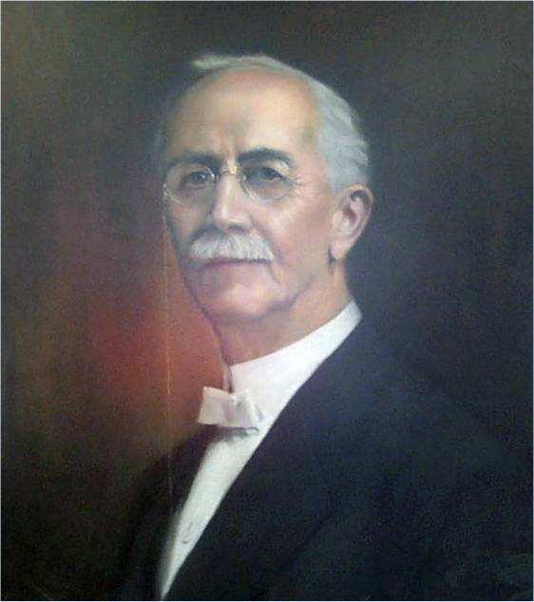
Arvy Glenn Freed (1863-1931)
“We make it an invariable rule to treat everybody with perfect civility, no matter what garb he wears or what infirmity he suffers.”
—A. G. Freed

Slide 2
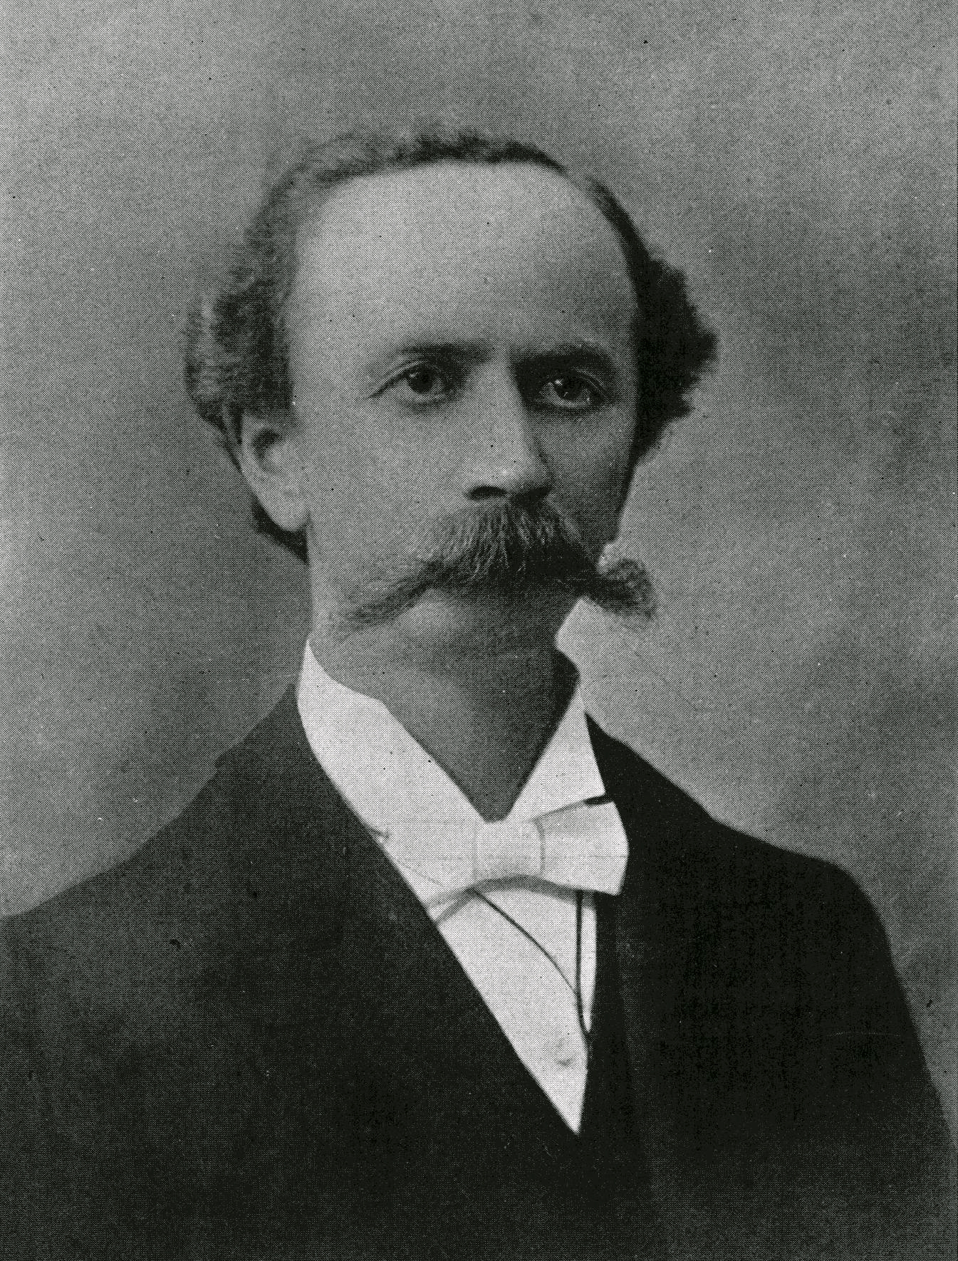
Early Life of Arvy Glenn Freed
Born in Saltillo, Washington County, Indiana August 3, 1863
Arvy Glenn was the third of six children born to Joseph and Eliza Ann Hays Freed
Graduated Lawrence County High School in 1880
Attended Southern Indiana Normal in Mitchell.
B.S. and M.A. Degrees
Attended 2 years at Valparaiso University for post-grad work.
By 1886 had acquired Instructor’s License - Qualified to teach 40 different subjects.
Notes:
Eliza was a relative to the nations 19th President, Rutherford B. Hayes (1877-1881)

Slide 3
W.H. Krutsinger’s Bible Training School Ellettsville, Indiana
AGF attended in Spring of 1888 with three others: Forrest Shackleford, E.O. Barnes & A.E. Freeman.
5am – 9pm daily
Daily sermons & recitations
Greek, Latin, Church History, Elocution, Homiletics, & Bible
Notes:
Recitation in the school began at 5am. Only time off for meals. Classes would go until 9pm. AGF had to preach a sermon every day.

Slide 4
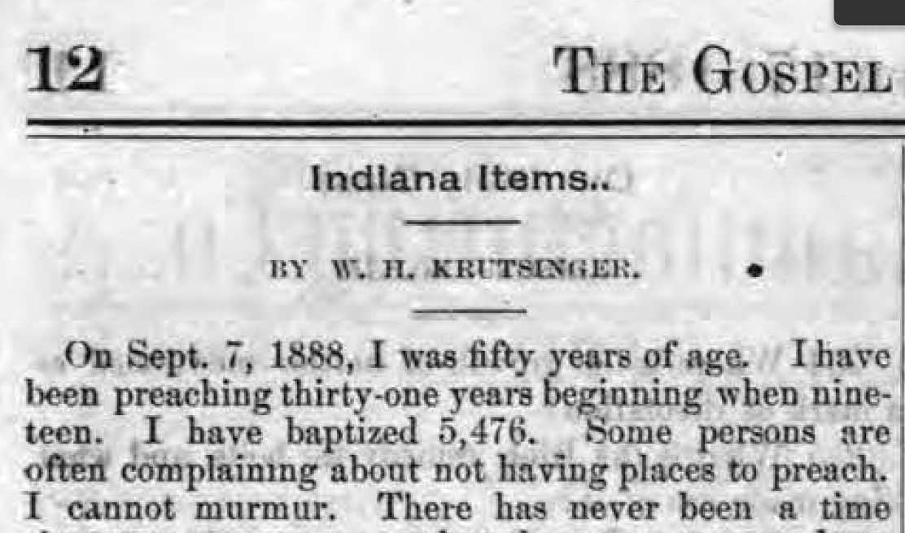
W.H. Krutsinger’s Bible Training School Ellettsville, Indiana
Other Students of Krutsinger: Horace Hinds, D.S. Ligon, A.J. McLaughlin, W.M. Davis, H.H. Adamson, F.L. Rowe & Ben. F. Taylor
(GA, 10.17.1888, 12)
Notes:
F.L. Rowe edited the Christian Leader
D.S. Ligon – Ligon Portraiture
W.M. Davis – Front page editor for Firm Foundation in the early 20th century
H.H. Adamson – well known preacher in southern Indiana
Ben F. Taylor -

Slide 5
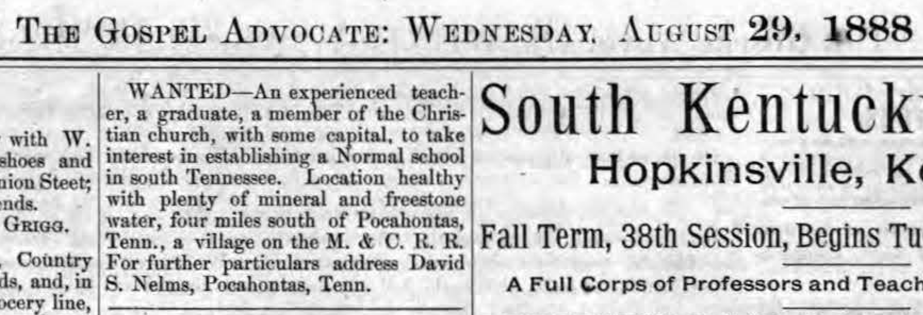
An Appeal From The South
GA 08.20.1888, p9, also 0905, p9
David S. Nelms’ Appeal in Gospel Advocate
Notes:
AGF once stated that he was educated at the feet of David Lipscomb – meaning that he read with devotion every issue of the GA.
David S. Nelms of Pocahontas, Tn – while he was an educator, he had children at home that needed more than he could offer
DSN Makes two appeals in the GA for a teacher to come and operate a school.
AGF answers the call, by writing to Nelms personally. He suggested that Nelms form a corporation, elect a board of trustees, and commence to building a school building.
M & C R.R. – Memphis & Charleston Railroad

Slide 6
The Southern Tennessee Normal College
09.1889-1920s
Notes:
Fall of 1889, AGF is 26 years old and he moves to the Big Hatchie River and begins STNC.
For the next 6 years he continues to try and build the college.
This 1892 advert expresses that 450 students were enrolled at the last session.
It was reported by one who visited in 1893 that there were 160 students.
Bible was not taught as a course, but daily chapel attendance was required.

Slide 7
A.G. Freed was in at least 35 debates
1st J.N. Hall (Baptist) in Corinth, Mississippi – August 21, 1894 – rode his bicycle to the debate.
Also, I.N. Penick; S.F. Cayce; P. Clark, A.A. Andrus, R.H. Pique, and others
1894 – taught 200 days, preached 300 times, baptized 200 people, traveled 5000 miles.
Notes:
An 1894 report told of Freed's work for the year.
School teaching had occupied 200 days. In addition he had
preached 300 times, baptized over 200 people, and traveled
over 5000 miles
Firm Foundation, Vol. X (June 12,1894). p. 6.

Slide 8
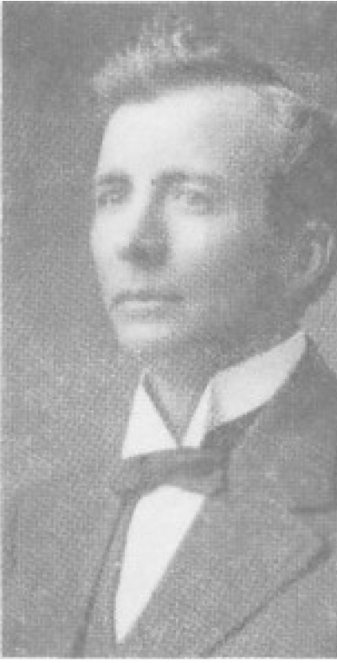
Words From A Student
“Brother Freed worked from sun-up to sun-down and walked through a pine grove of trees to and from school. Since all were poor and from the farm his pay was not over $60.00 per month. Only about fifty people lived in the little country village. The water in that fine mineral spring within one-hundred feet of Hatchie River was a drawing card.
– J.T. Stricklin, Fort Worth, Texas Firm Foundation, 7.26.1955 p.488
Notes:
J.T. Stricklin wrote a piece in the Firm Foundation in 1955. He was 85 at the time and one of the early students at the school.

Slide 9
Words From A Student
“The Southern Tennessee Normal College grew rapidly. In the early nineties Brother Freed got a bicycle. He used it to make calls and to meet a train to meet his appointments at Corinth, Miss. Memphis, Tenn., etc. Those churches paid him about $5.00 for appointments.
“He kept a nice repeating rifle. I have hunted with him. He could hit the mark.
“The college grew to two boarding houses and many boarders in private homes.
– J.T. Stricklin, Fort Worth, Texas Firm Foundation, 7.26.1955 p.488

Slide 10
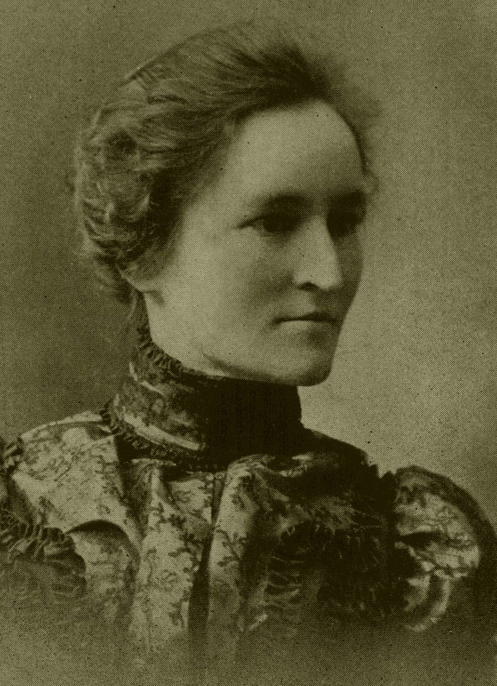
Cora Belle Baynham Freed June 1, 1895
Notes:
Cora Bell Baynham was born in 1870, she was 7 years younger than Freed.
J.T. Stricklin wrote in his piece recalling being in their wedding. He said,
“At the close of the last session there in 1895. Brother Lewis Edwards and I were asked to stay over two days for Freed's marriage to a pupil, Miss Cora Baynum. We had black suits so we were the flower boys. Brother Northcross officiated.” J.T. Stricklin – 1955 – Firm Foundation.

Slide 11
Move to Henderson, Tennessee
Notes:
By the time of the marriage AGF had already been courted by the board of directors at WTCC in Henderson.
AGF had made several trips into the area, and had preached at the Christian Church there on the campus.
C.H. Duncan had been the leader at WTCC after G.A. Lewellen’s departure in 1893, but the school was declining under his leadership.

Slide 12
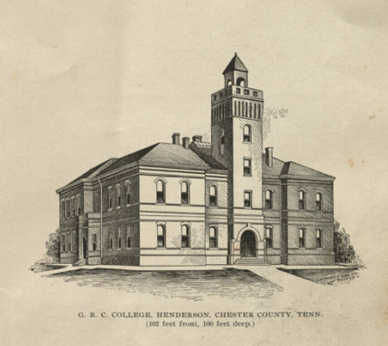
1895-1897
West Tennessee Christian College invites AFG to Henderson to take the presidency of the College.
10 year contract.
1897 the school was enduring the end of a half decade national economic downturn. Needed Money, and a School building.
Citizens of Henderson contributed $5000.
J.F. Robertson of Crockett Mills, Tn. Contributes $5000, and the name of his late daughter George Ann.
Georgie Robertson Christian College
NB Hardeman joins the faculty while working on his graduate degree, serves as Associate Principal
Notes:
J.F. Robertson of Crockett Mills, Tn. Contributes $5000, and the name of his late daughter George Ann. School’s name is changed to Georgie Robertson Christian College in the fall of 1897.

Slide 13
Arvy Baynham Freed (1899-1901)
Notes:
The Freeds suffered a loss of a special infant son at the turn of the century.
Typhoid Fever -

Slide 14
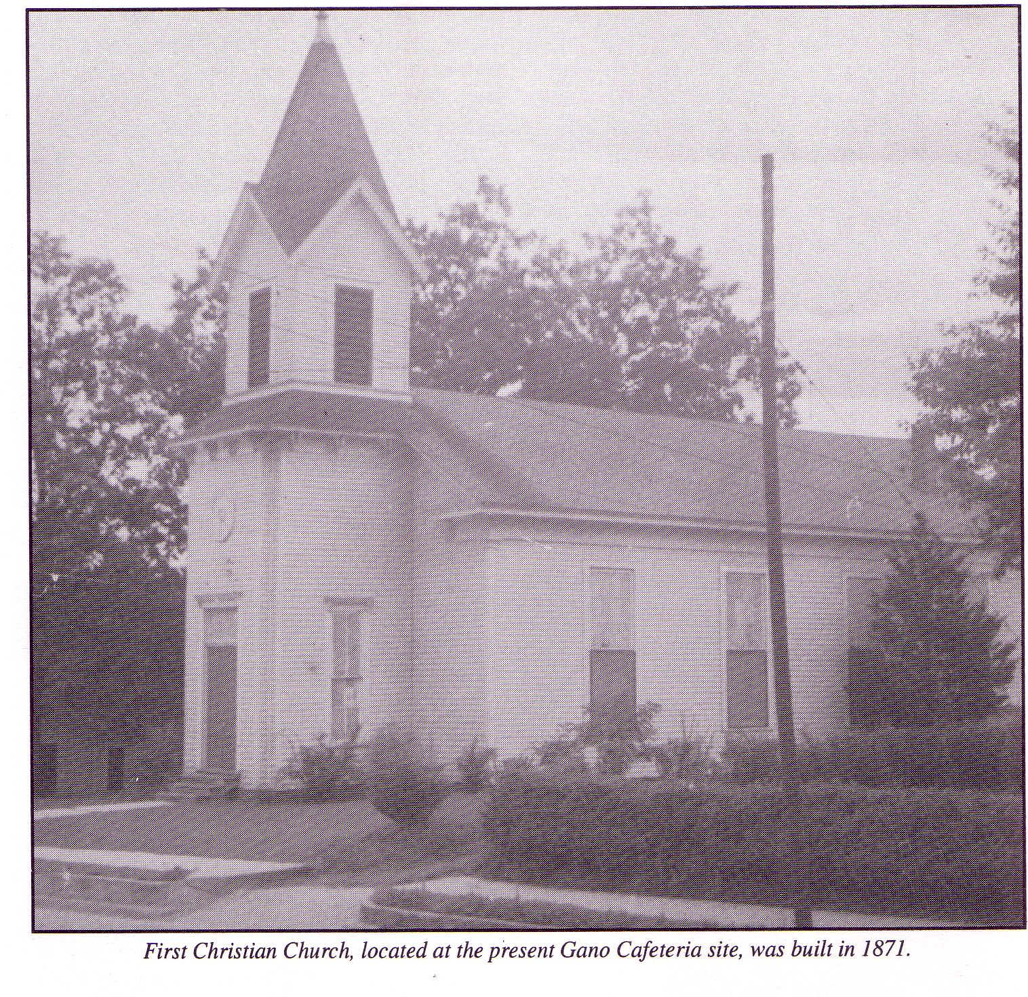
Growing trouble in the Christian Church
A.G. Freed opposed instrumental music in the worship, yet the congregation at Henderson was instrumental.

Slide 15
1902
The Board hires E.C. McDougle as Co-president with AGF of GRCC

Slide 16
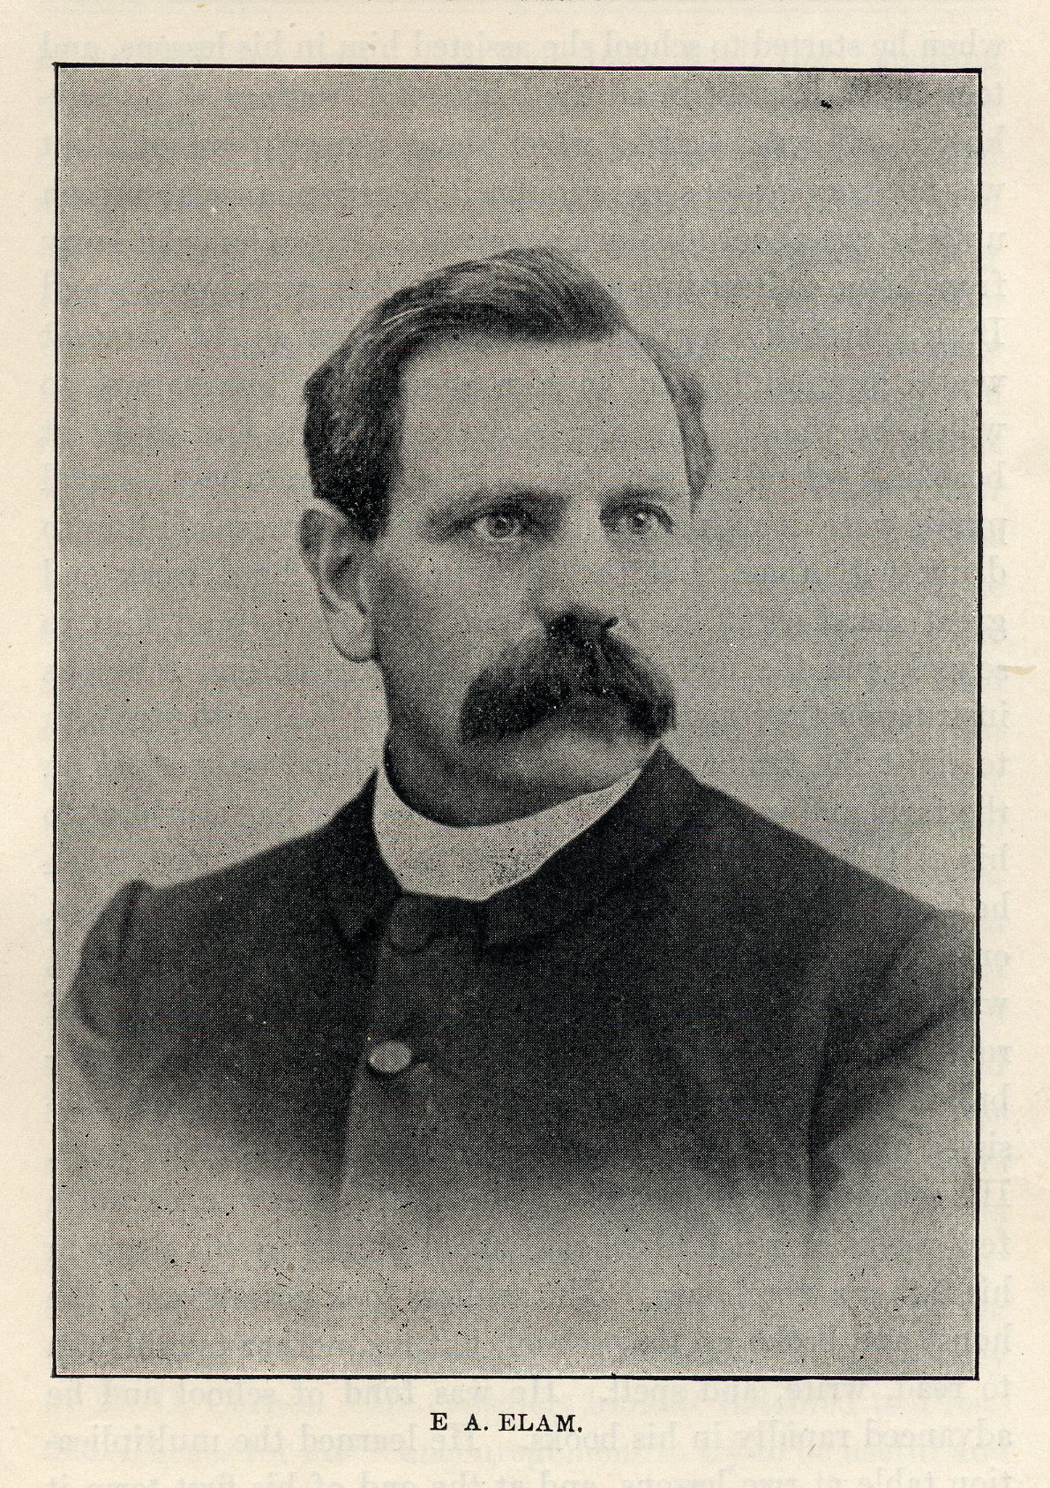
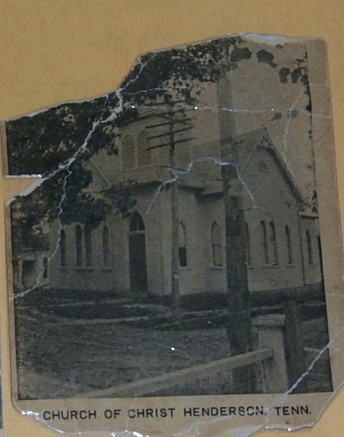
Division of 1903
A.M. St. John invited E.A. Elam to come speak on the instrumental music.
Jan. 1903 Elam arrives – R.P. Meeks
Division over the instrument and societies followed.
Henderson church of Christ was established, with A.G. Freed & A.M. St. John became elders and N.B. Hardeman the preacher.
Fall – Joe S. Warlick/J. Carroll Stark Debate on Instrumental Music
Summer – The property of GRCC is quietly deeded to the Tennessee Christian Missionary Society
Fall – The church moves into the new building on cnr. Crook Ave. & E. 2nd

Slide 17
1905-1907
Spring – Freed & Hardeman depart the school.
Hardeman becomes Sup. of Education & Teaches School
GRCC closes doors within 2 yrs.
A.G. Freed moves to Denton, Texas to becomes president of Southwestern Christian College the following year.
August 19, 1906 – Stricken with Typhoid Fever.
Returns to Tenn. In Jan. 1907
Notes:
SWCC – starts in 1904 – H.G. Fleming is dean of the college. F.L. young, veteran preacher, heads the Bible Department, R.H. Boll, Jesse P. Sewell and George Klingman make up the faculty.
They needed a leader – AGF comes to visit in the spring of 1905 – signs a 5 year contract for $2000.00. Starts in the fall.
While on a preaching trip back to Tenn – stricken with Typhoid

Slide 18
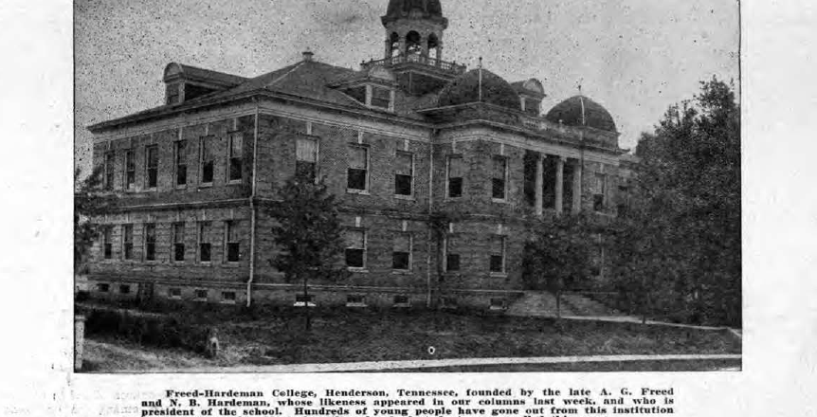
1907-1908
Nov. 11, 1907 Groundbreaking for Admin Bldg. National Teachers Normal and Business College
Sept 10, 1908 – Grand opening - AGF - President/NBH V.P.
The two share ownership of school
Notes:
Contact the The Missionary Society about using the GRCC building – they are denied. – So, start building.
GRCC closes in the spring of 1907.

Slide 19
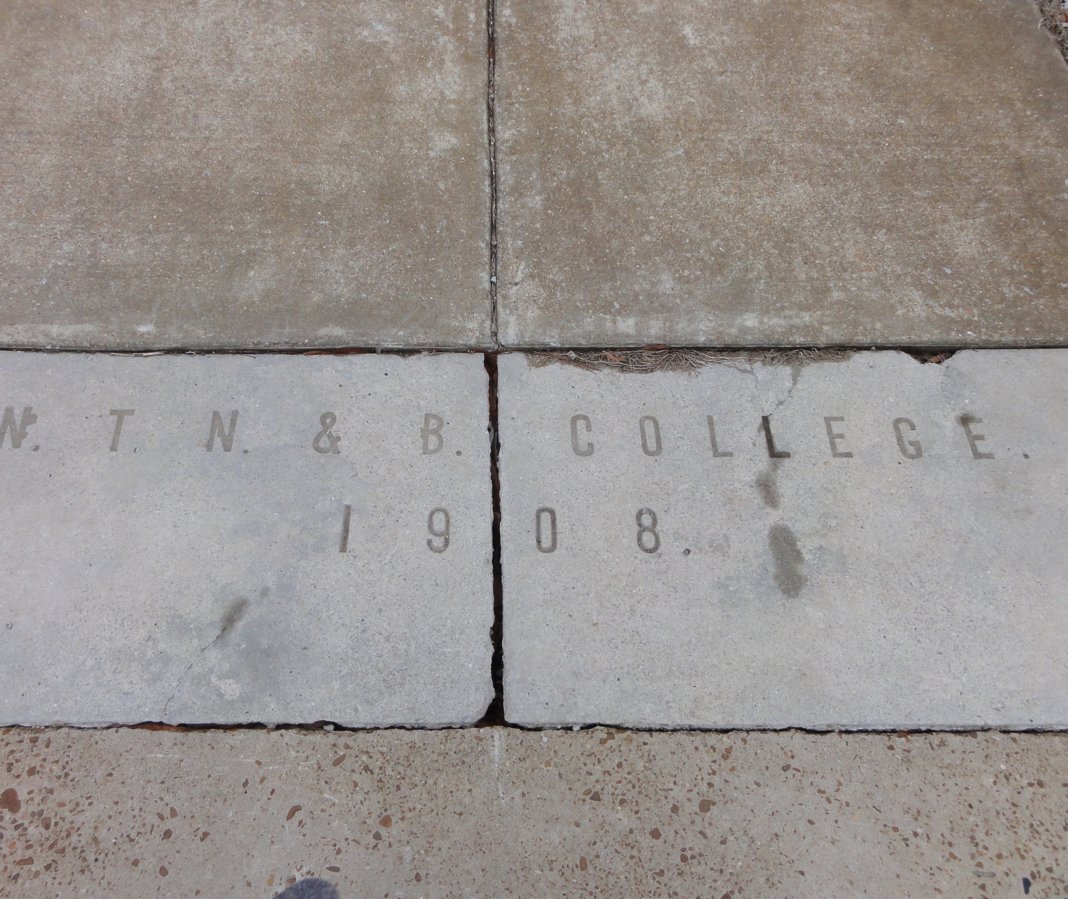
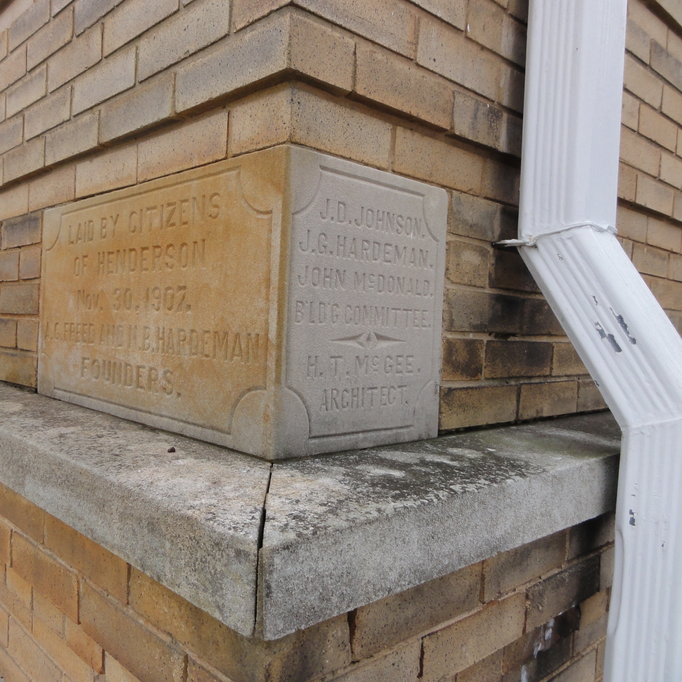
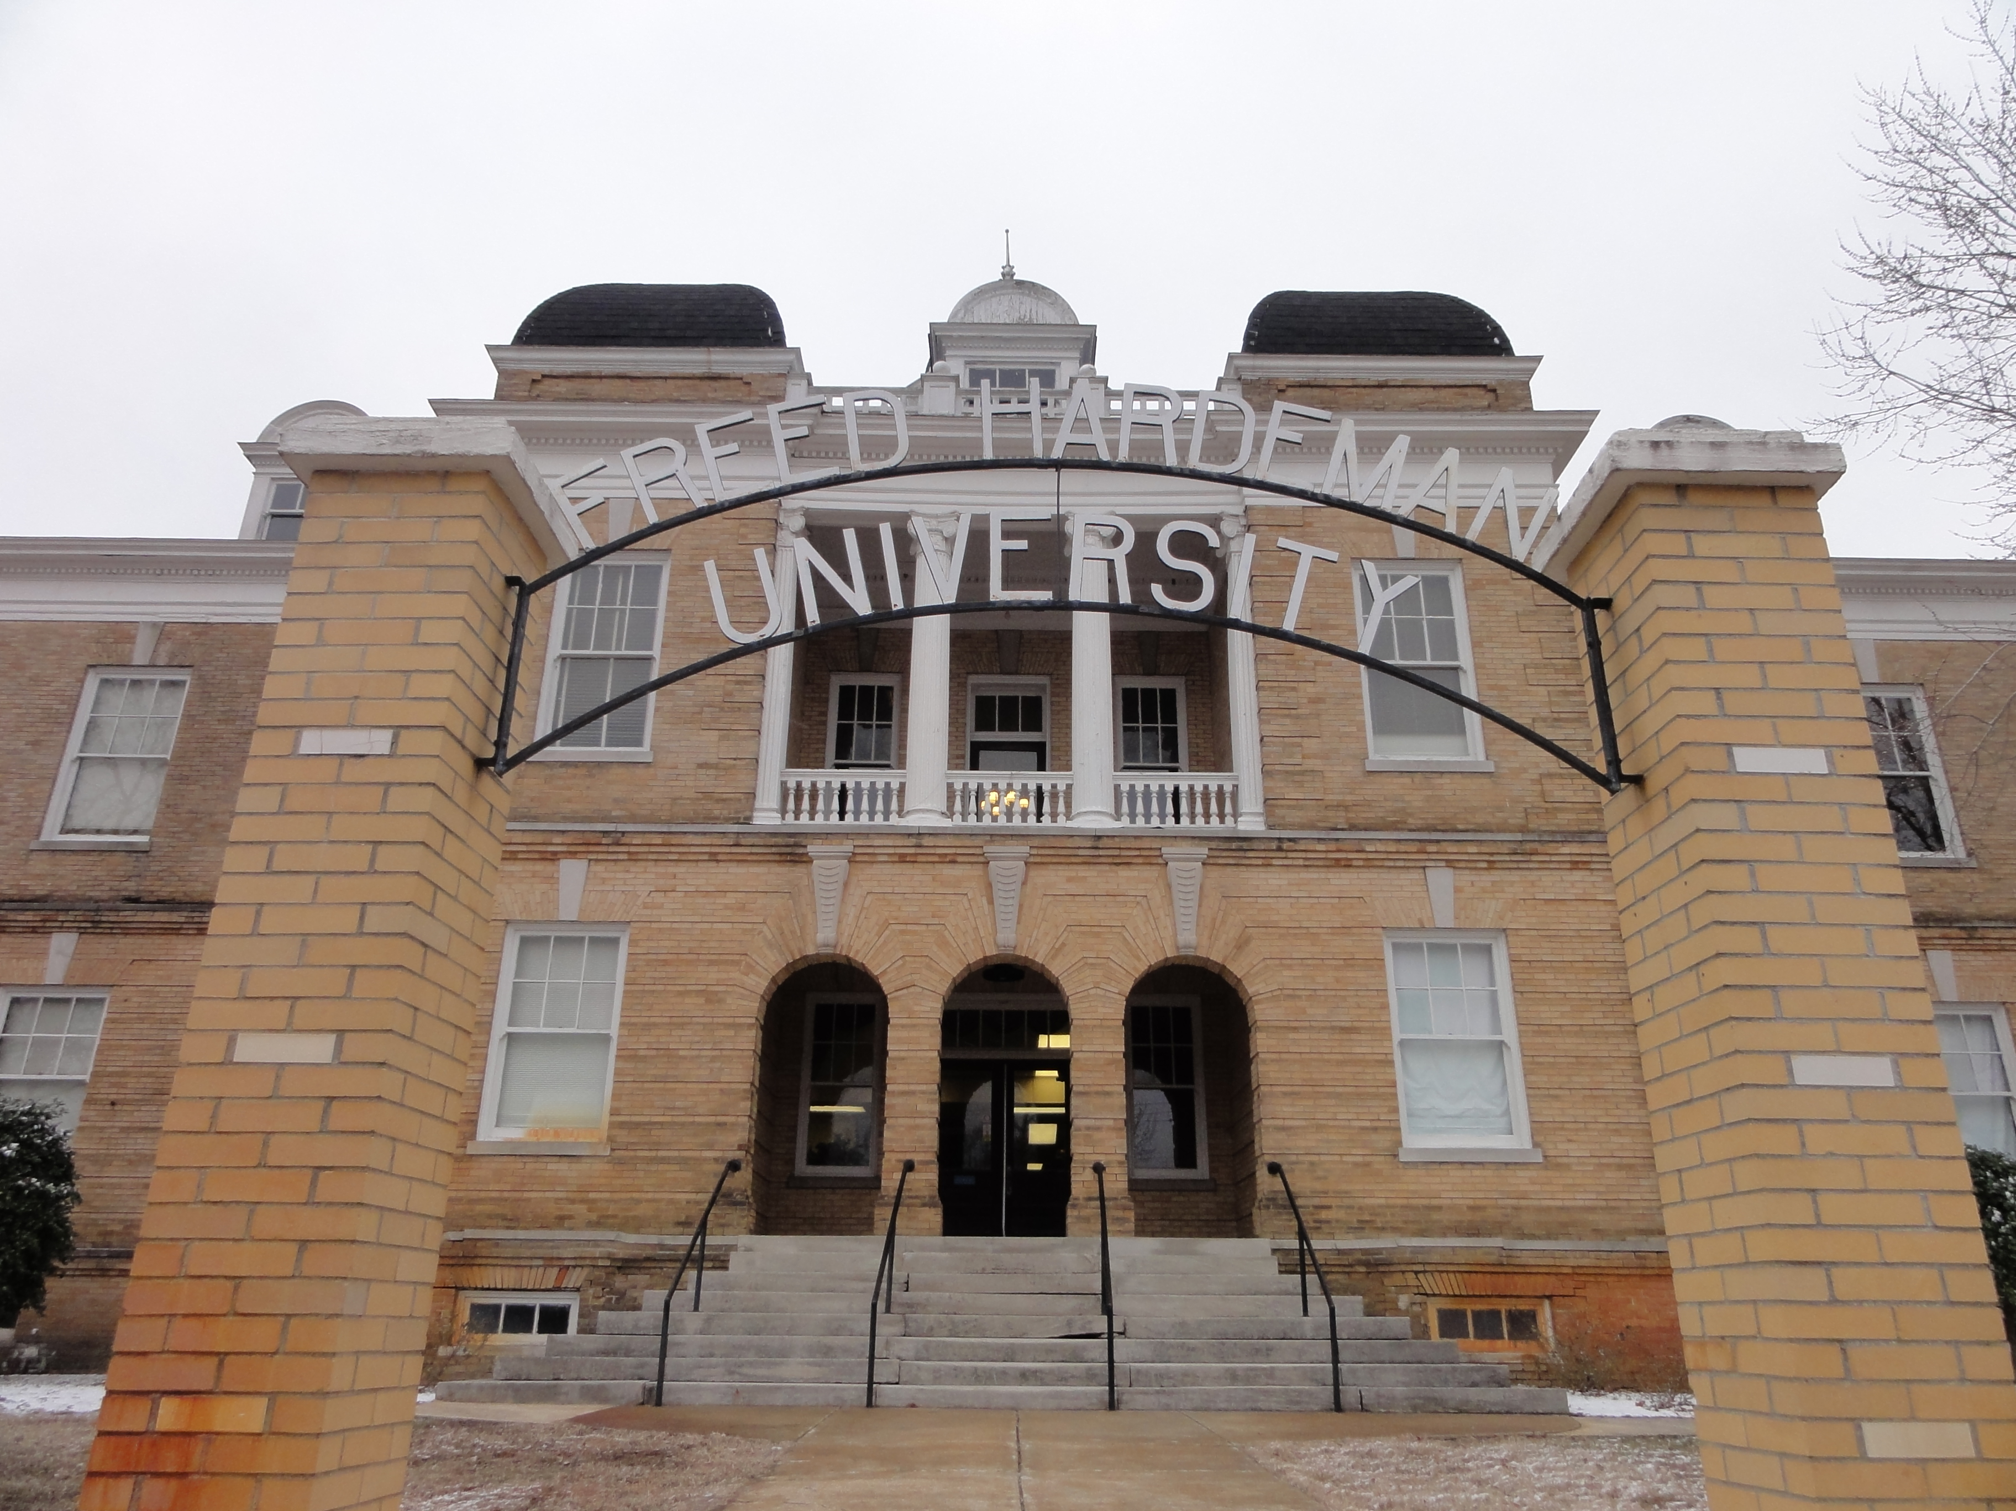
National Teacher Normal & Business College 1908-1919
From Fall, 1908 with
600 enrolled

Slide 20
NTN&B College Declining Years Beginning in 1914
State run Normal colleges established at Memphis, Murfreesboro, and Johnson City.
Influenza epidemic
Declining Economic Conditions
World War 1 - 1917
Notes:
American Ship liner – Housatonic was sank – America declared war! (Lusitania was English)

Slide 21
Freed-Hardeman College 1919
March 25, 1919 - The NTN&BS is sold to a board of Trustees and renamed Freed-Hardeman College for $30k
Money began to be raised for a girls, and later, a boys dormitory

Slide 22
Freed-Hardeman College

Slide 23
Decline In Relationship
Disagreements on Discipline
Accreditation vs. Normal
Hardeman’s other interests
Freed was 11 yrs Hardeman’s senior
Hardeman’s success as a preacher

Slide 24
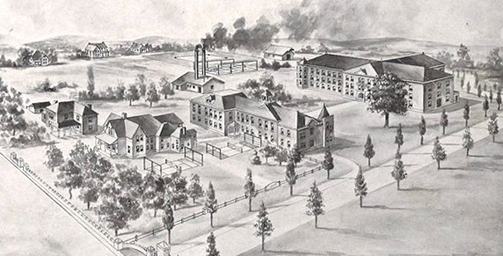
To David Lipscomb College
Troubles increase in leadership – AGF spends the 1921-1922 school year away from the college raising funds.
1923 - A.G.F. departs to David Lipscomb College where he serves as VP under President H. Leo Boles.
AGF also serves as principal of high school.
Preaches meetings and conducts debates.

Slide 25
David Lipscomb College
Becomes a 4-year college in 1924
AGF Preaches in meeting work/fill-ins/debates
1927 – Accepts challenge to raise $1 million
A.G. Freed, E.A. Elam, H. Leo Boles

Slide 26
A.G. Freed & Debating
Debated Bogard in 1927 and 1928 in Nashville & Little Rock
http://www.encyclopediaofarkansas.net/encyclopedia/entry-detail.aspx?entryID=1593#
Benjamin Marcus Bogard (1868–1951)
As told Ancil Jenkins by E.R. Harper - Biography of A Gentleman, A.G. Freed, p.95

Slide 27
1927 - Differences settled between Freed & Hardman
Gospel Advocate, October 6, 1927, p. 941

Slide 28
Penmanship

Slide 29
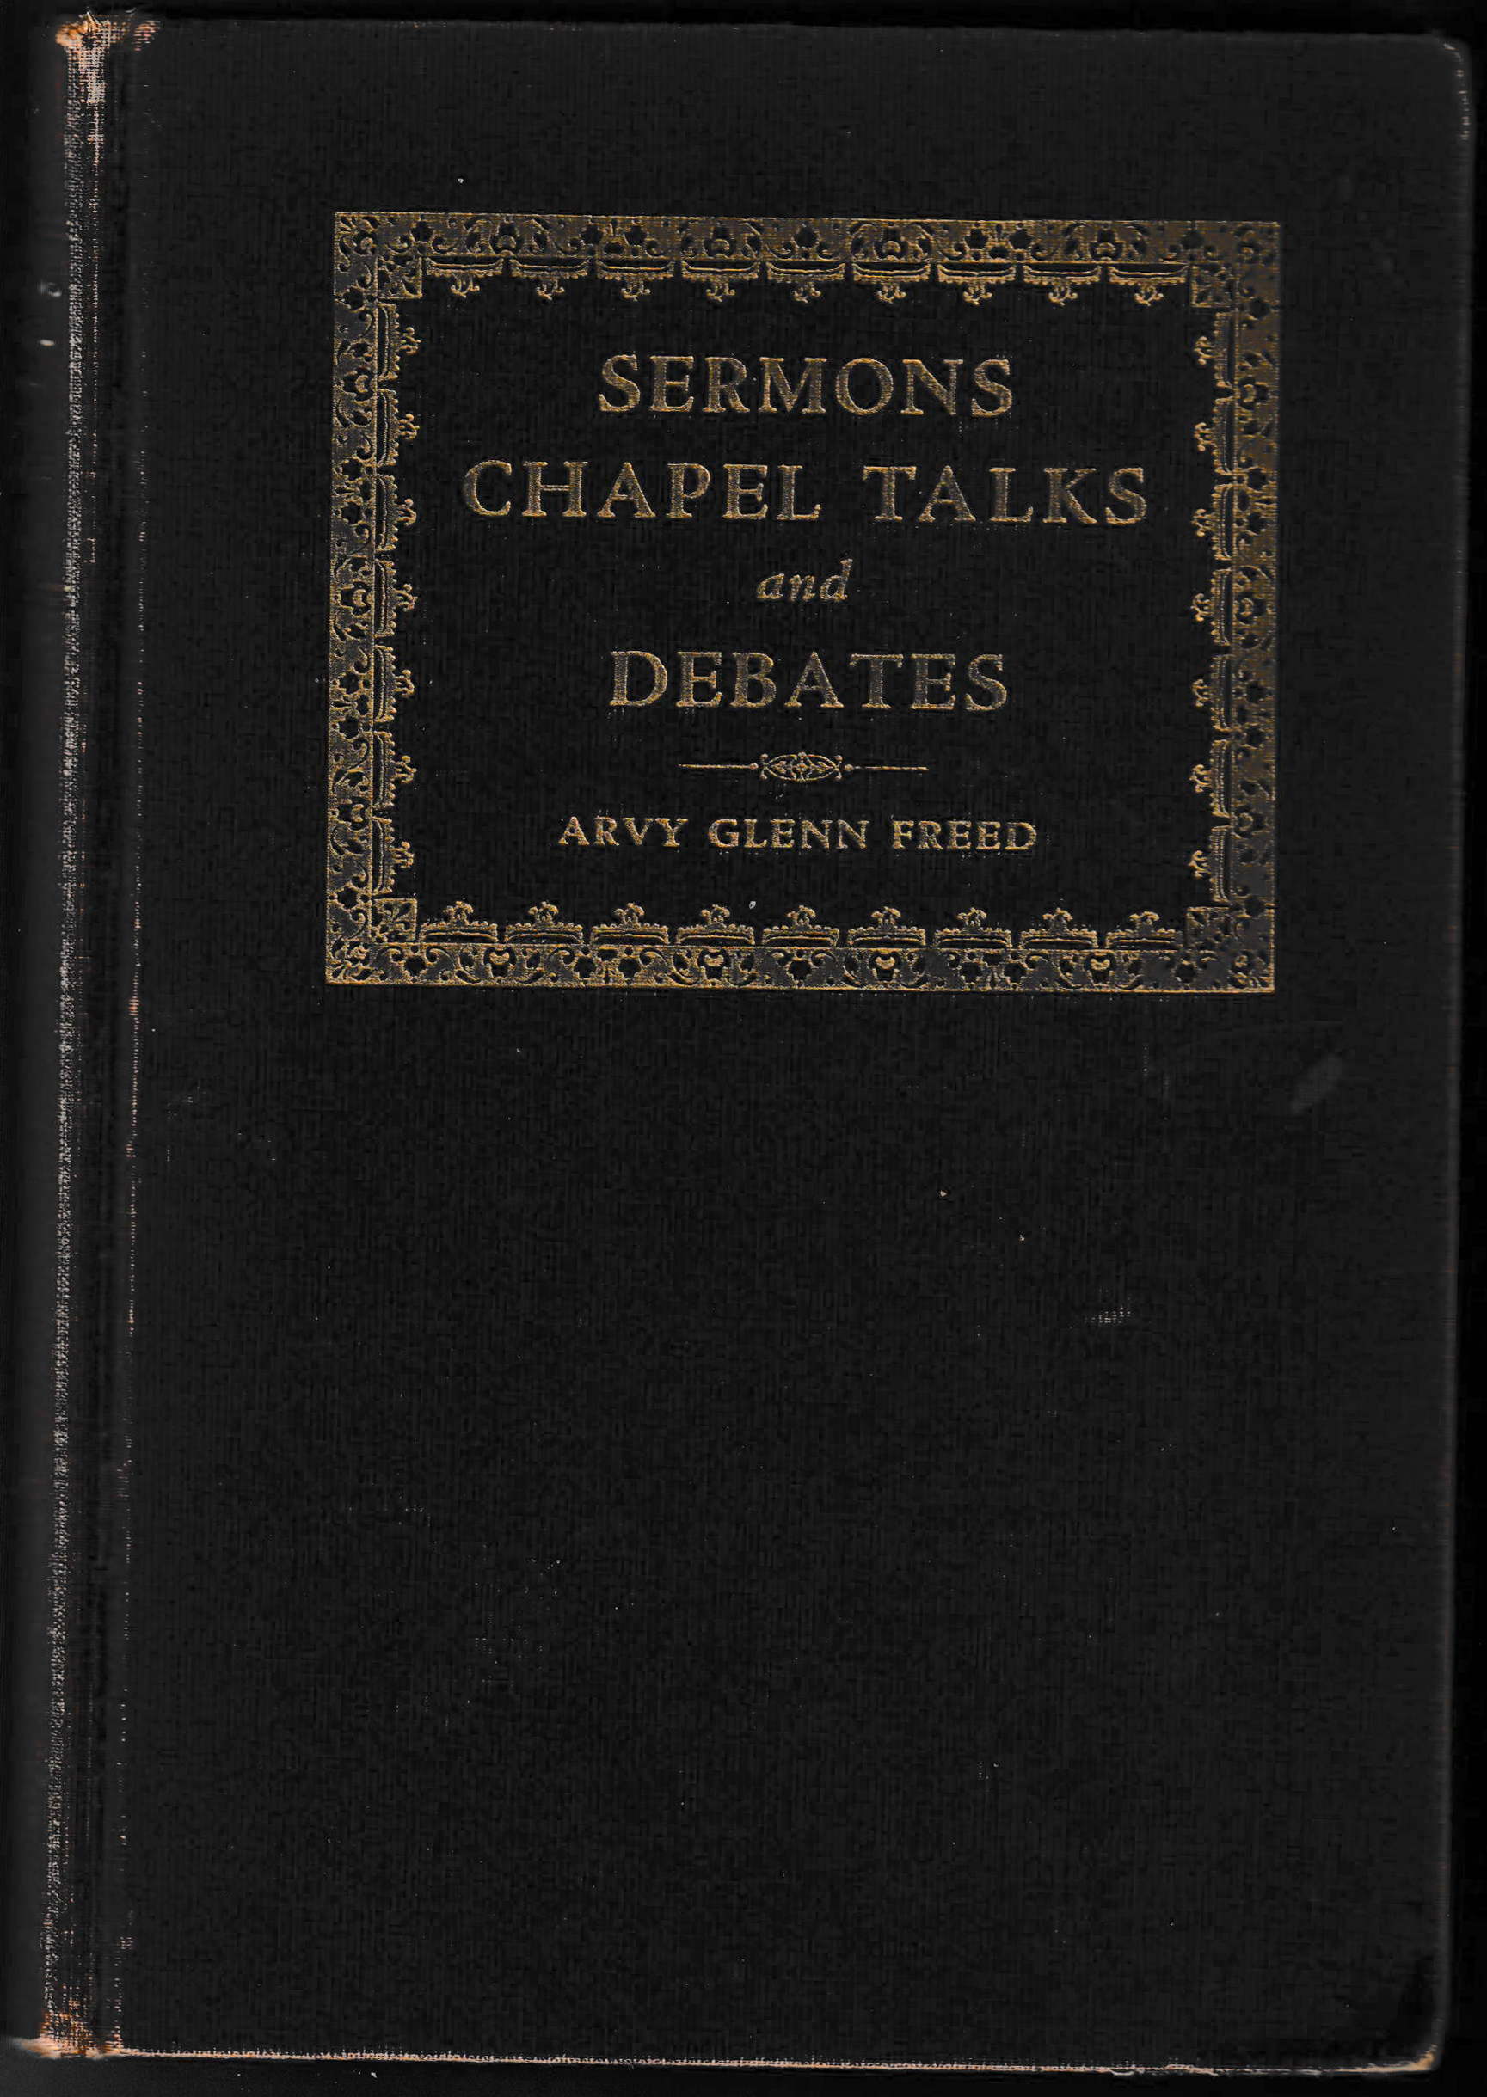
A Volume By A.G. Freed
November 1, 1931 A.G. Freed’s Book, Sermons, Chapel Talks and Debates is published

Slide 30
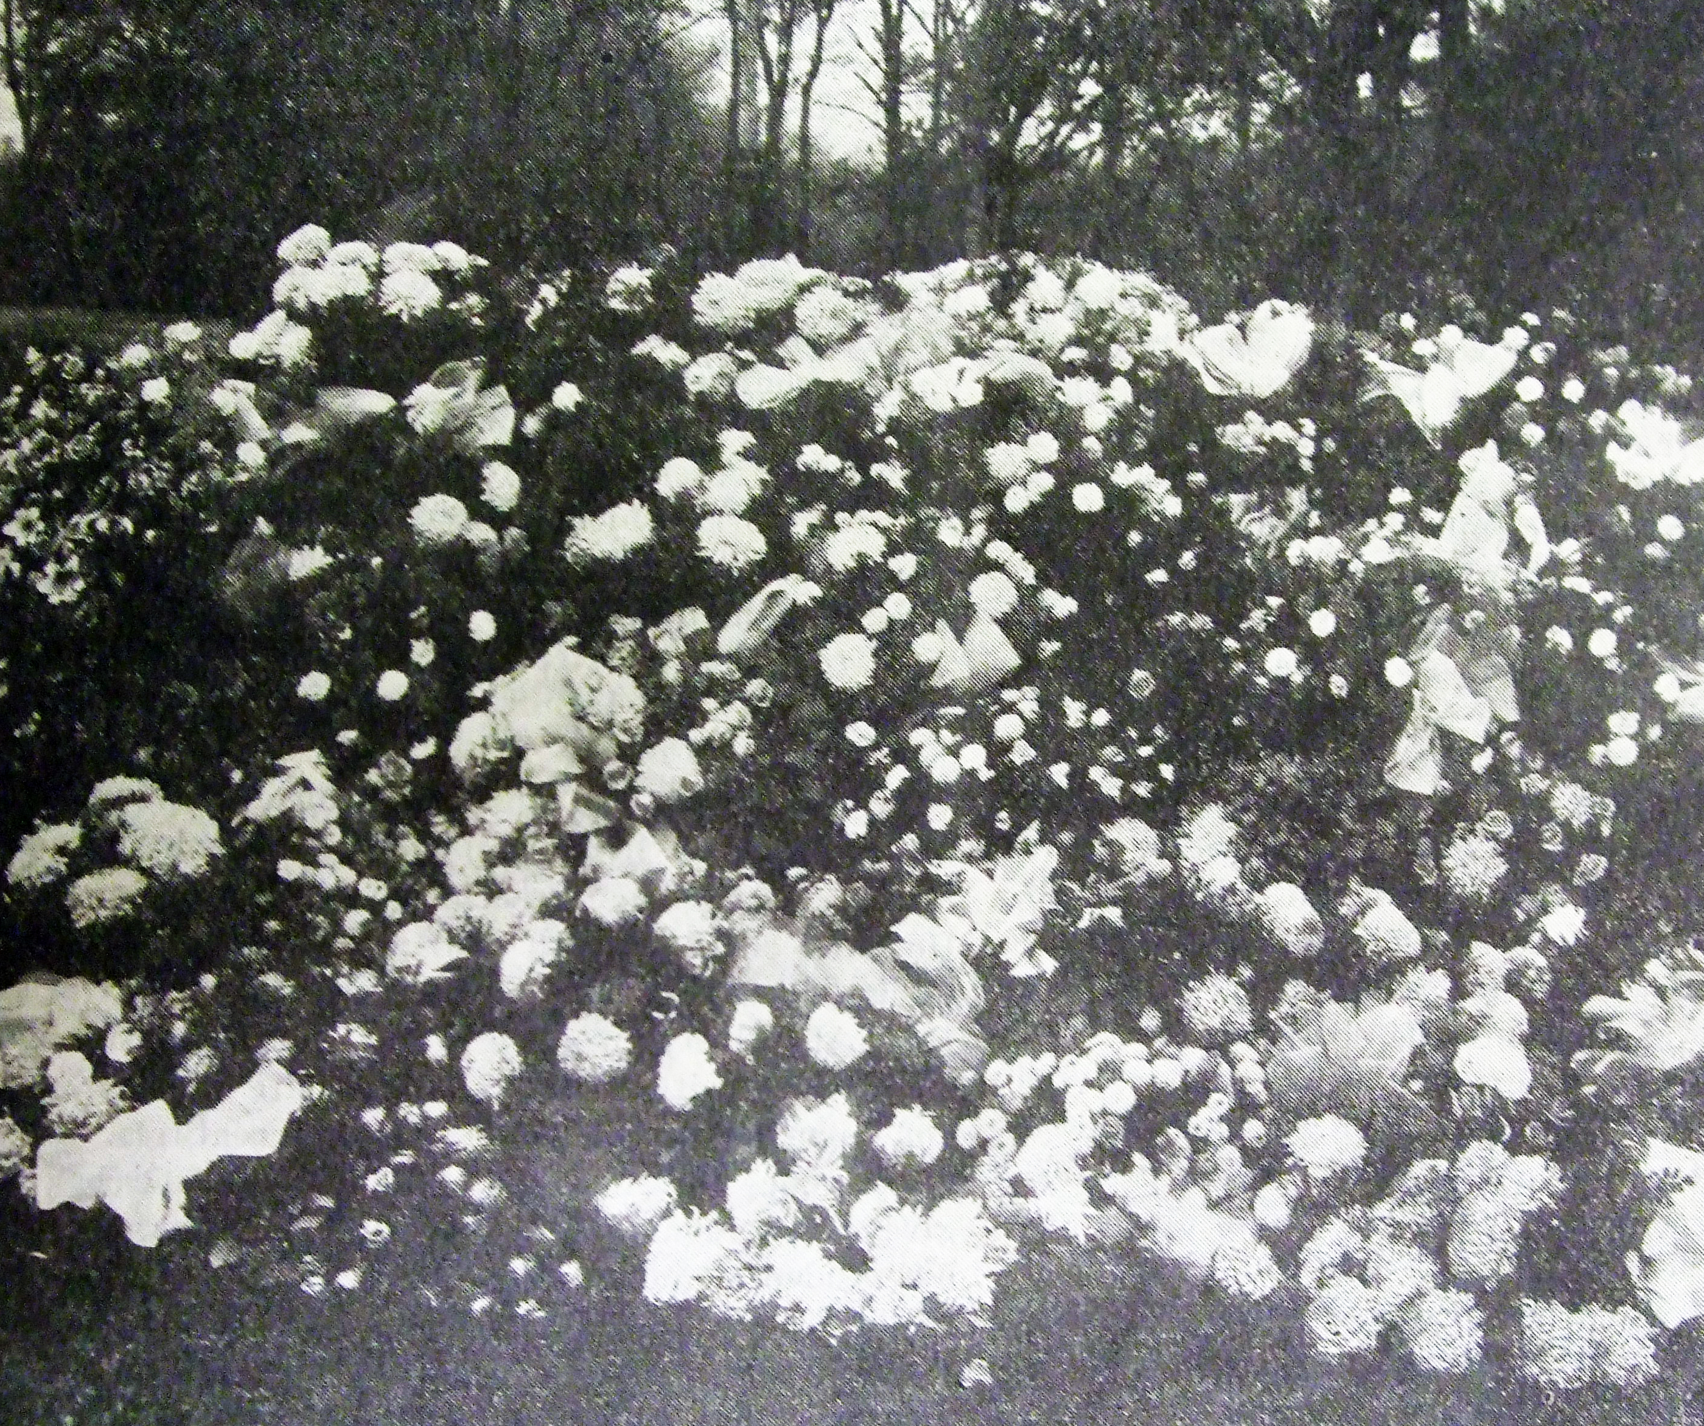
Passing Of A Man Of God
“So, when some morn you hear I'm gone, You'll know, friends, where to find me; In that land fair where all things there Of sweet things here remind me.
The Fatherland beyond, above The silent-flowing river, Where they who work, and learn, and love, All meet, and live forever!”
-Wilbur Fisk Tillett, Sermons, Chapel Talks, and Debates, p.11,12
November 11, 1931

Slide 31
Special GA Issue
December 31, 1931
H.M. Phillips – Student
C.E.W. Dorris – Neighbor
H.L. Calhoun – Faculty GRCC
I.A. Douthitt – Trustee FHC
C.M. Pullias – Board DLC
J.B. Nelson – Preacher
S.H. Hall – Board DLC
Chester Estes – Student DLC
W.S. Long – Student FHC
H. Leo Boles – President DLC
Others

